Slide 1
Embedded Valve and Actuator Sensors
Bray International
MEEN 402 Final Presentation
Avery Haynes, Locke Lehmann, Travis Carlson, Cody Sims, Zachary Walker, Michael Hager
April 25, 2024

Slide 2






Introductions
Locke Lehmann
Avery Haynes
Michael Hager
Cody Sims
Travis Carlson
Zack Walker

Slide 3
Agenda
Problem Introduction
Concept Generation
Risk Analysis
Concept Setup & Testing
Validation Discussion

Slide 4
Problem Introduction

Slide 5

Bray International
Bray is a premier manufacturer of flow control and automation products and accessories since 1986.
Wide portfolio of isolation & control valves, actuators, and smart devices that demand high degrees of reliability.
Incentivised to invest heavily in R&D to improve product design & performance.
Notes:
Cody

Slide 6
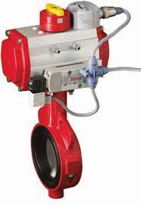
Problem Definition
Problem: Over its service life, a valve becomes stiffer & an actuator outputs less torque.
Effect: Unexpected downtime due to valve and actuator failure affects project schedules.
Motivation: There is a need to produce real time data to track the performance of this system over time.
Notes:
Cody

Slide 7
Project Deliverables
Two Main Project Goals:
Develop a method of directly determining true valve position, independent of an actuator.
Develop a method of directly determining actuator output torque, independent of a valve.
Notes:
Cody

Slide 8
Customer Needs
# | Need | Importance
1 | Final product is embedded into the actuator casing | 1
2 | Product is scalable for different-sized valves | 2
3 | Product records and transmits sensor data | 1
4 | Works in a wide temperature range (-40℉-300℉) | 4
5 | Works under various pressures (100 psi - 740 psi) | 3
6 | Works for various fluid mediums | 4
7 | Measures actuator torque to < 5% error | 1
8 | Relatively short lead times for parts (3-4 weeks) | 2
9 | Determines true valve position independent of actuator | 1
10 | Works for both pneumatic and hydraulic actuators | 3
11 | Short time for calibrating the sensor | 3
Notes:
Travis

Slide 9
Design Requirements
The final solution should…
Be embedded into the valve & actuator
Ensure accurate position and torque readings
Record and transmit sensor data
Be scalable to various valve and actuator sizes.
Be compatible with a wide range of input pressures.
Be user-friendly and reliable.
Notes:
Cody

Slide 10
Design Standards
Industry Codes and Standards to adhere by:
US Federal Code Section 49, CFR 195.116 - Transportation of Natural and Other Gas by Pipeline
ASME B16.34 - Valves, Flanges, Fittings, and Gaskets
ISO 5210:2023 - Industrial Valves and Actuator Attachments
Notes:
Cody
These were the codes and standards we considered when selecting a concept. Mention how abiding by these codes were discussed in a previous semester and since we did not have fluid flowing through our experimental setup, we did not need to make these codes a top priority.

Slide 11
Concept Generation

Slide 12
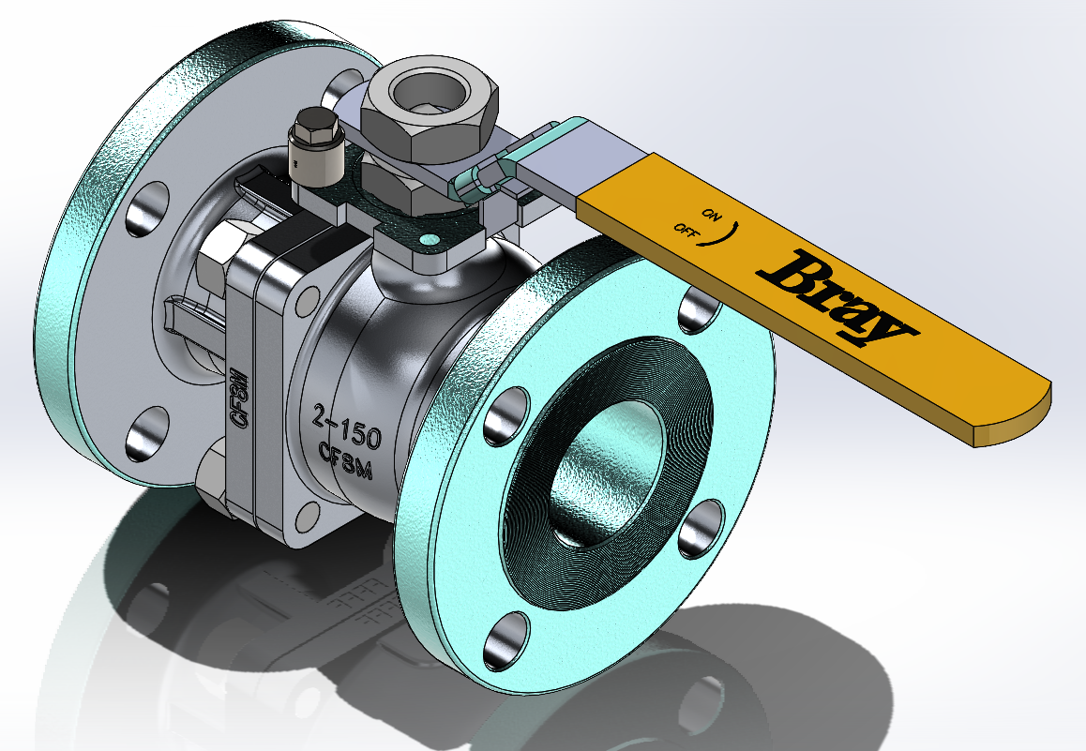
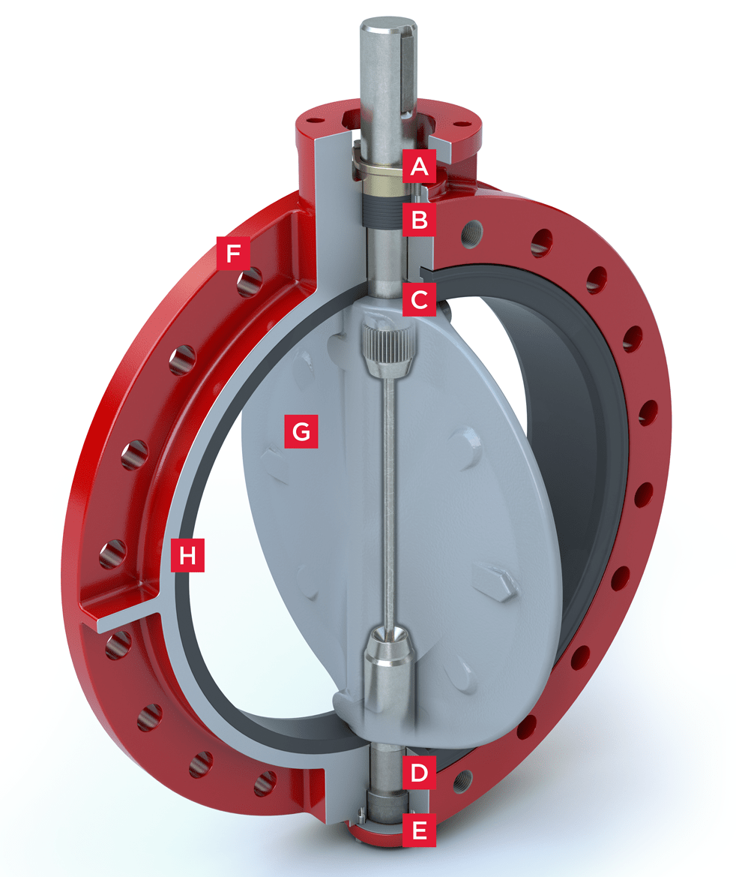
Relevant Products
Butterfly and ball valves
Focusing on ball valve due to higher engineering complexity.
Project solution should be agnostic to valve type.
Notes:
Cody

Slide 13
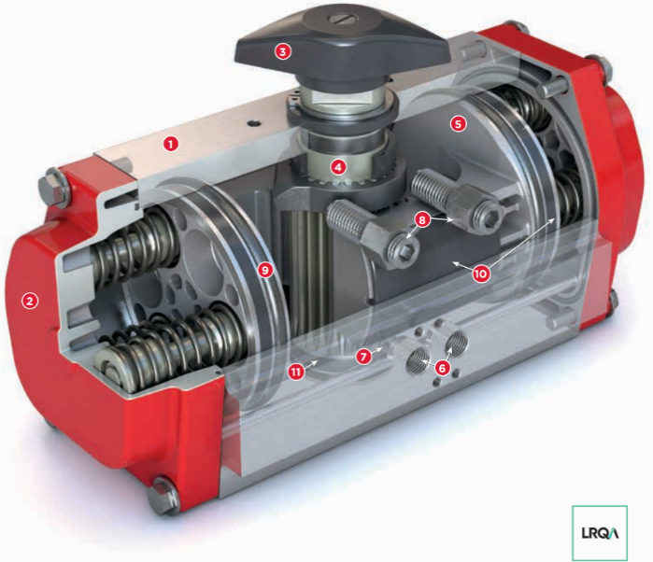
Relevant Products
S92 rack-and-pinion actuator [3]
Notes:
Cody

Slide 14
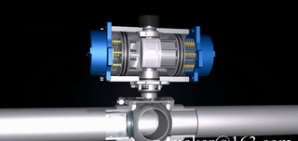
Valve - Actuator System
Pressurized air enters the actuator chamber
Air pushes pistons to turn valve stem
Valve stem turns the valve base to allow/restrict fluid flow
Pressurized air or springs return pistons
Valve & Actuator animation with fluid flow [2]
Notes:
Cody

Slide 15
Concept Selection Criteria
Only direct measurements preferred for better accuracy
Should not apply calculations to measured data (rules out measurements of fluid flow)
Most important solution characteristics:
<5% error for torque, <2% error for position
No interference with system performance
Solution embedded into valve & actuator system
Notes:
Avery

Slide 16
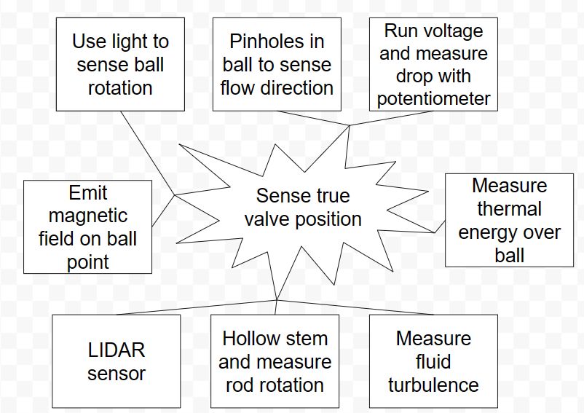
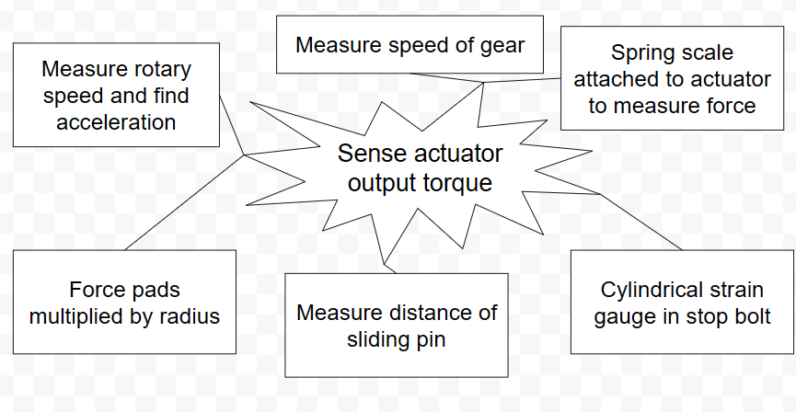
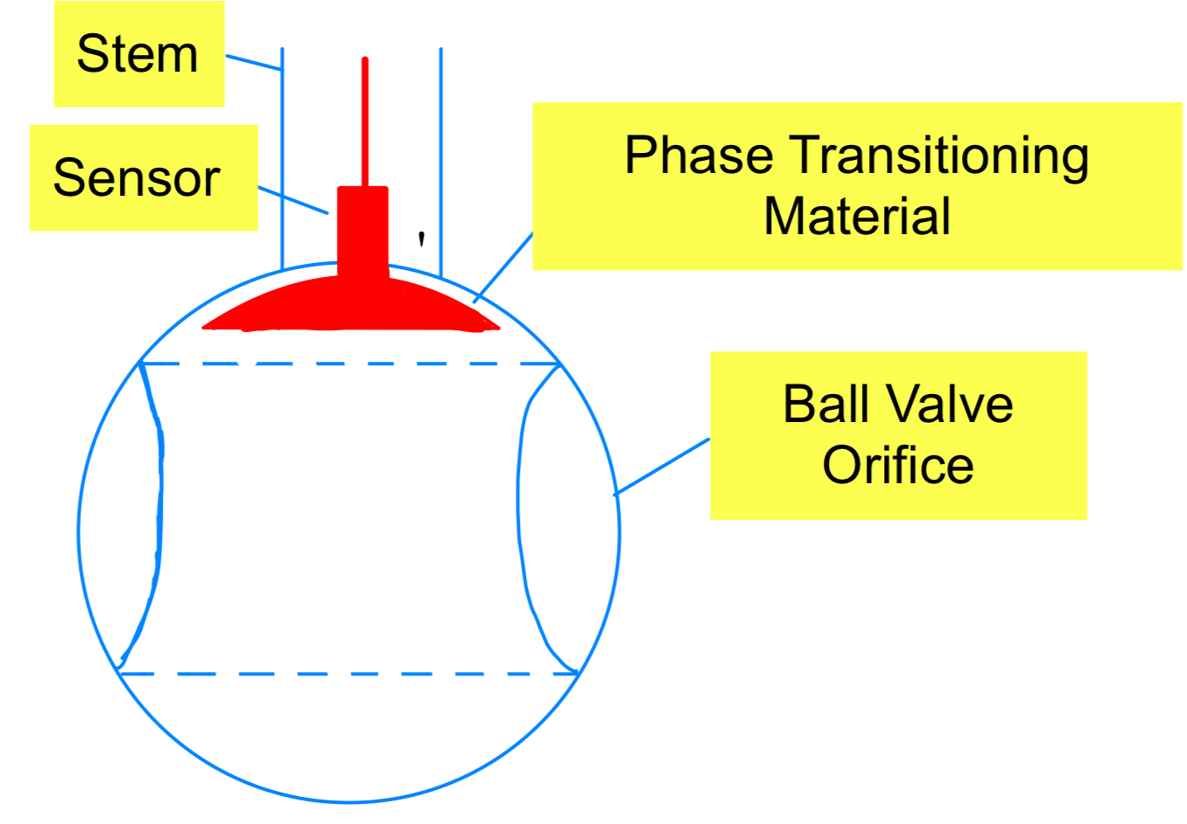
Concept Generation
Several different methods were utilized for idea generation for the position and torque problems.
Brainstorming Map
TRIZ
Design by Analogy
“Analogy” based methods worked better within our group
Brainstorming Maps
TRIZ Ball Valve Concept
Notes:
Avery

Slide 17
Concept Selection
Problem: The two goals (position & torque) are highly independent, and no concept stood out as an obvious solution
Resolution: Design & test two possible solutions for each deliverable.
Valve Solutions - measure valve position
Potentiometer
Hall Effect Sensor
Actuator Solutions - measure output torque
Stop Bolt Strain Gauge
Electric Motor
Notes:
Avery

Slide 18
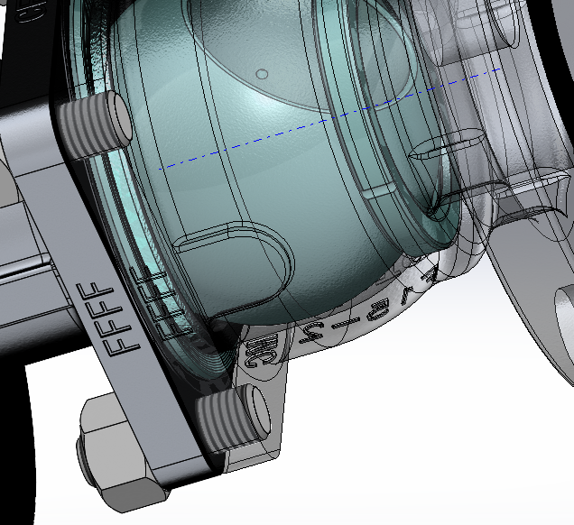
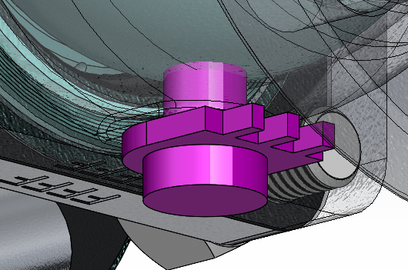
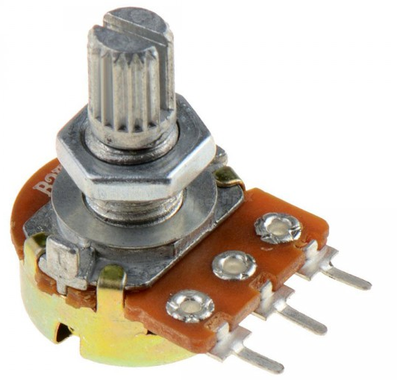
Potentiometer
Measure exact valve position
Placed inline to axis of rotation on bottom of valve (avoids valve stem)
Potentiometer base fixed to valve casing, sensor stem inserted into ball
Hole through valve casing - must re-seal (outside scope of work)
Rotary Potentiometer
Sensor Placement on Ball Valve
Notes:
Travis

Slide 19
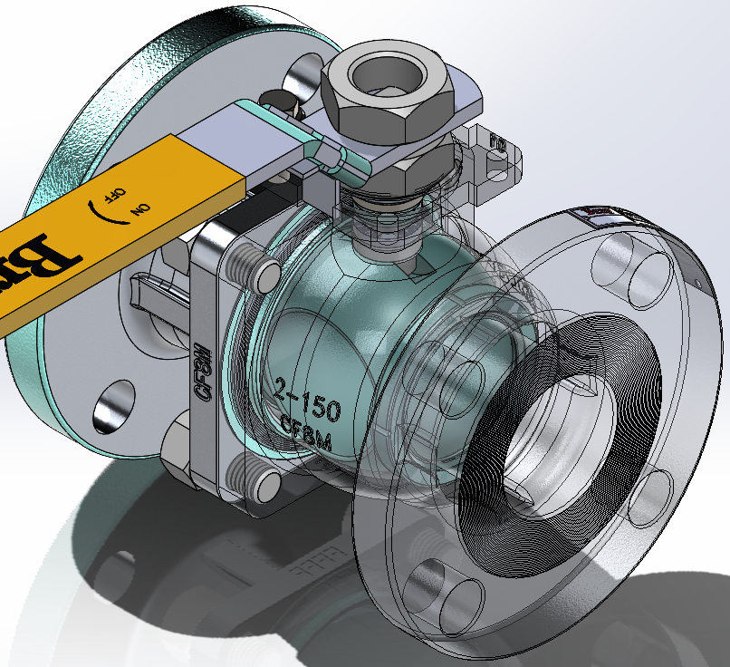
Hall Effect Sensor
Measure exact valve position
Attach a magnetized material or magnetize a spot on valve
Must determine “standard” magnetic field alignment at open/close positions
Determine material effects of valve on HE readings
Embedded in casing or stem
Magnetic spot
Sensor in stem
Notes:
Travis

Slide 20
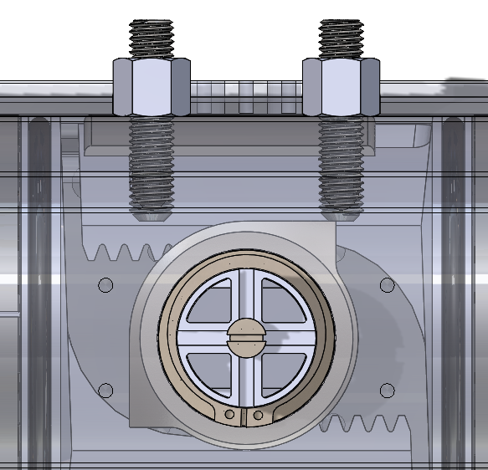
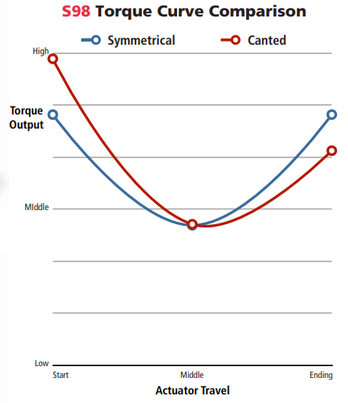
Cylindrical Strain Gauges
Strain gauge in actuator stop bolts
Drill small holes into stop bolts
Capture
compressive
force
A, E
F
R
Notes:
Travis

Slide 21
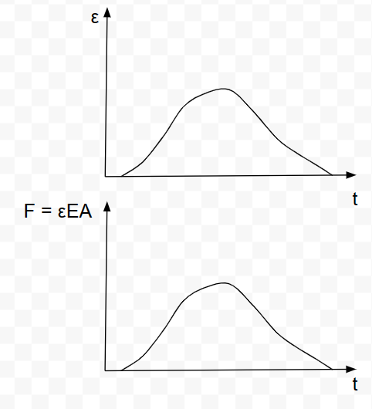
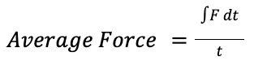
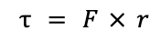
Cylindrical Strain Gauges
Measure discrete torque
Record strain (ε) vs. time (t) andand
Record applied torque for every toggle over time
Notes:
Travis

Slide 22
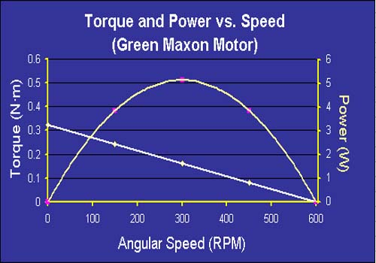
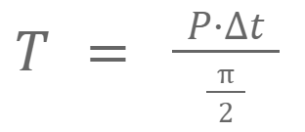
DC Motor EMF Measurement
Running Concept:
Torque units: Nm ← distance
Energy Units: J = Nm ← displacement
Conversion: E = 𝜏*[rotation in radians]
Assume rotation = 𝜋 / 2
DC Motor Usage:
Record back-EMF induced by actuator rotation
Motor in line with a known resistance, a total power can be found
How motors rotational speed correlates to the torque and power [11]
Notes:
Locke

Slide 23
Risk Analysis

Slide 24
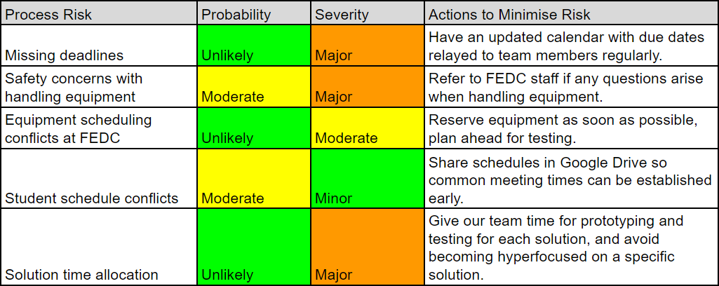
Process Risk Assessment
Notes:
Michael

Slide 25
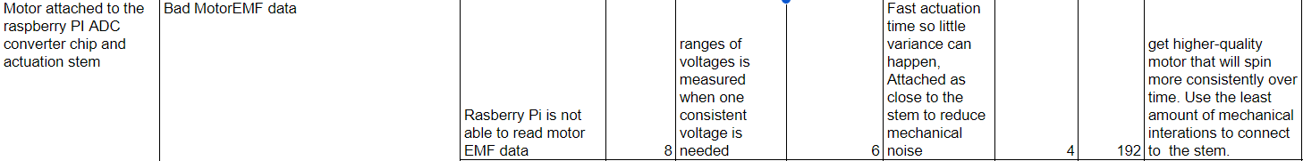
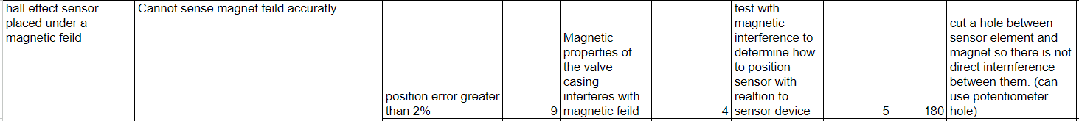
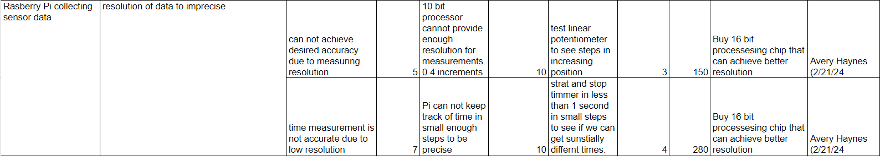
FMECA
Notes:
Locke

Slide 26
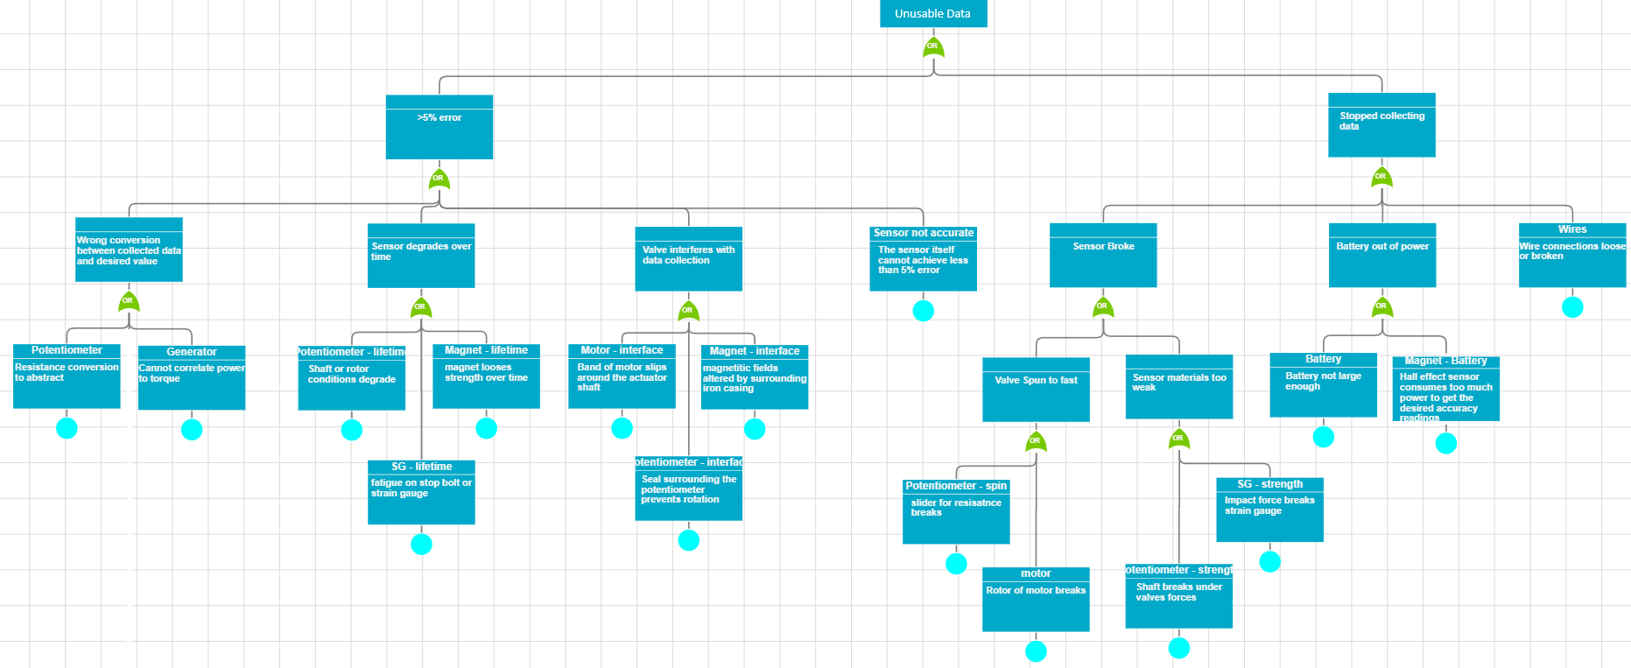
Risk Assessment
Preliminary Risk Analysis using Fault Tree Analysis
Notes:
Locke

Slide 27
Concept Setup

Slide 28
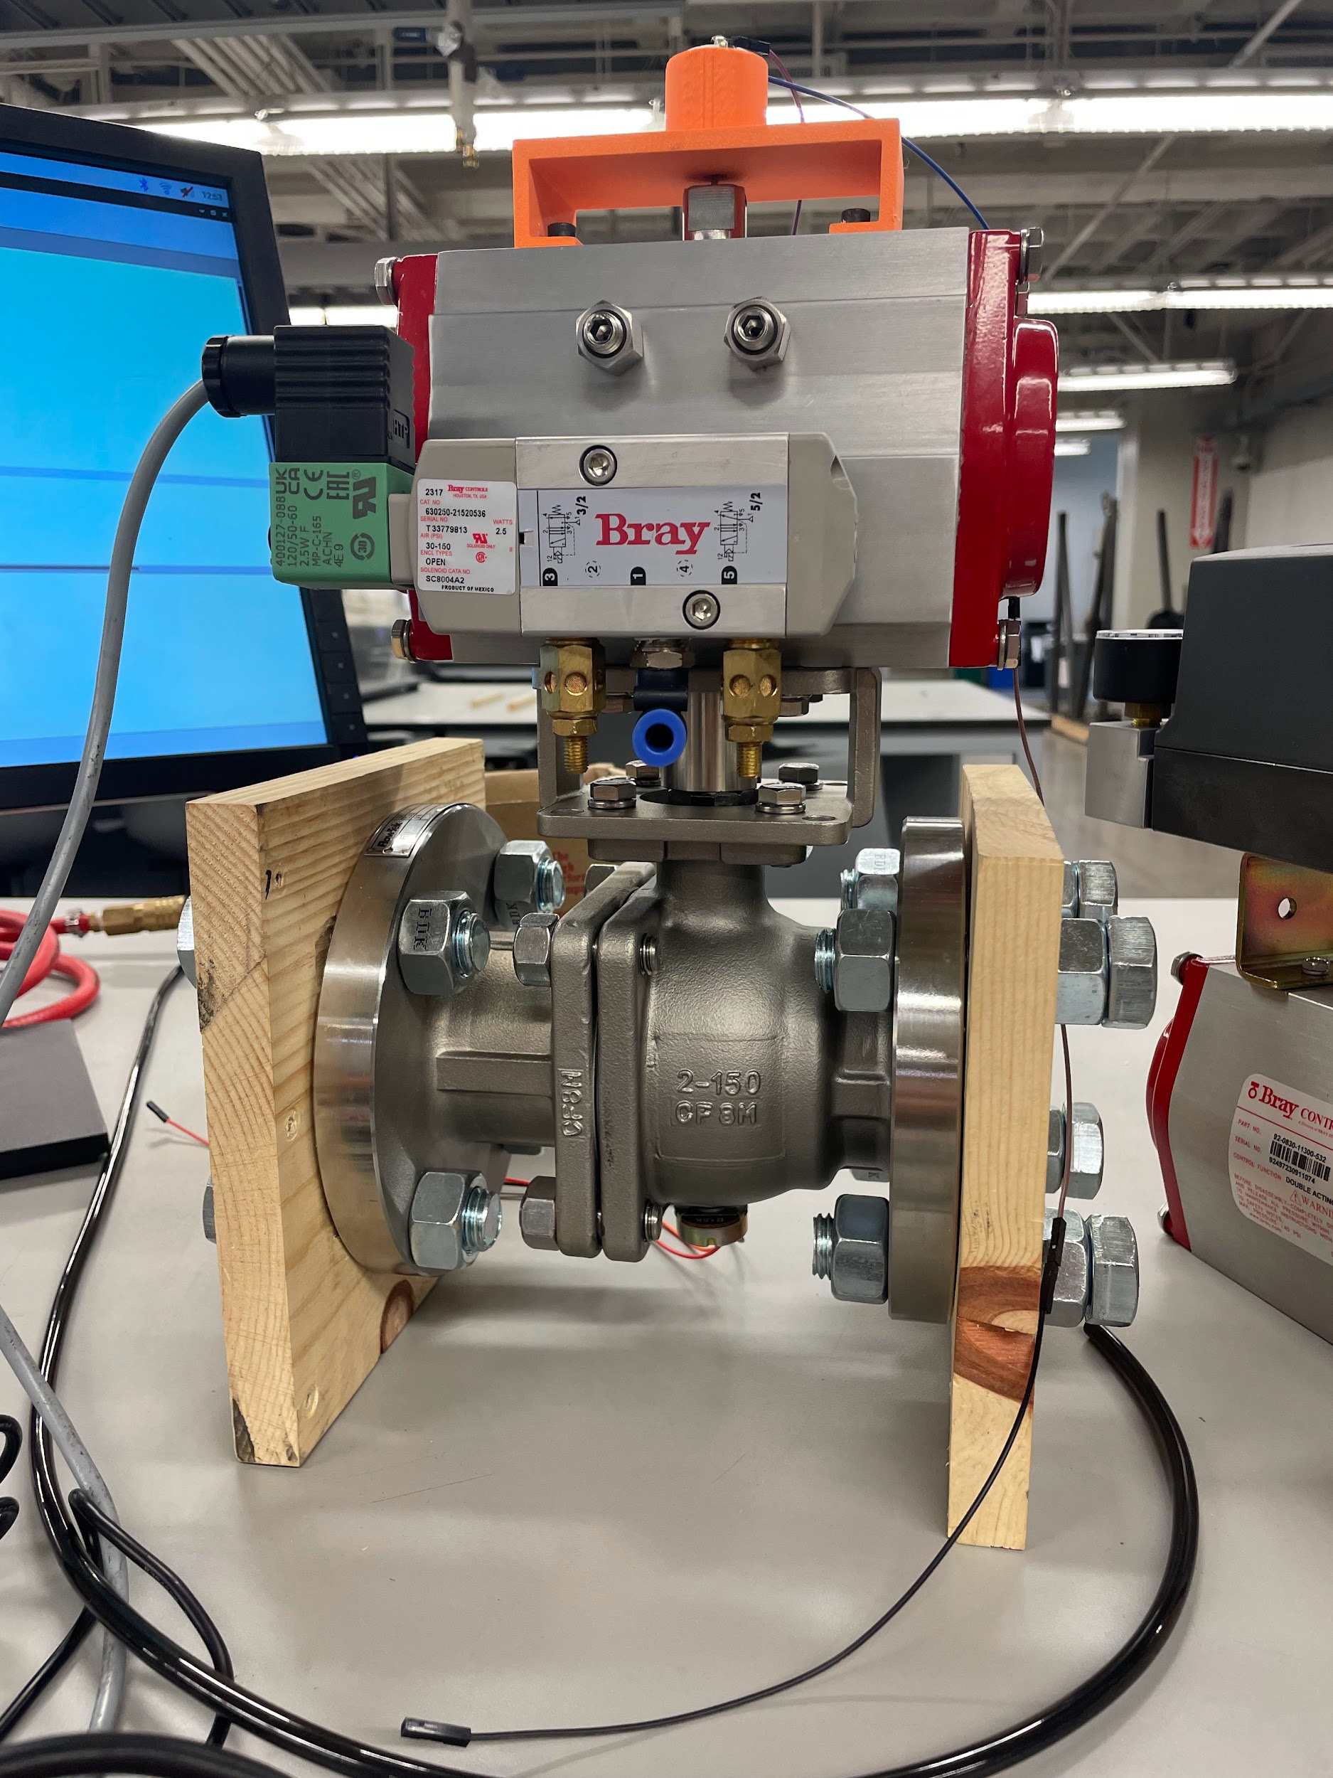
Full System Overview
One position and one torque sensor - any combination could be possible due to independent nature
Wooden slabs to hold valve upright
Raspberry Pi wired to whichever sensor was being tested
Figure: Connected valve-actuator setup.
Notes:
Zack

Slide 29
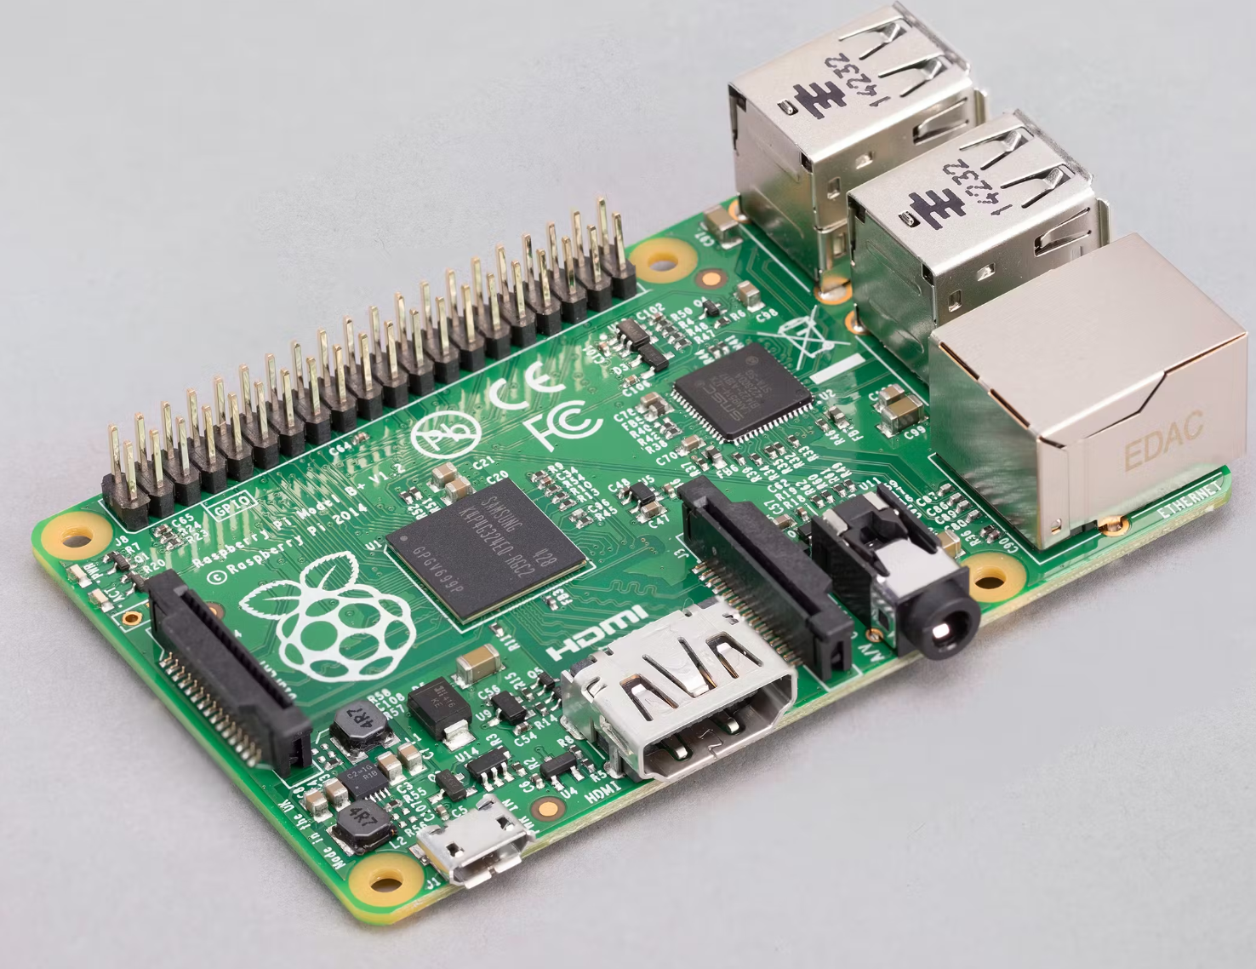
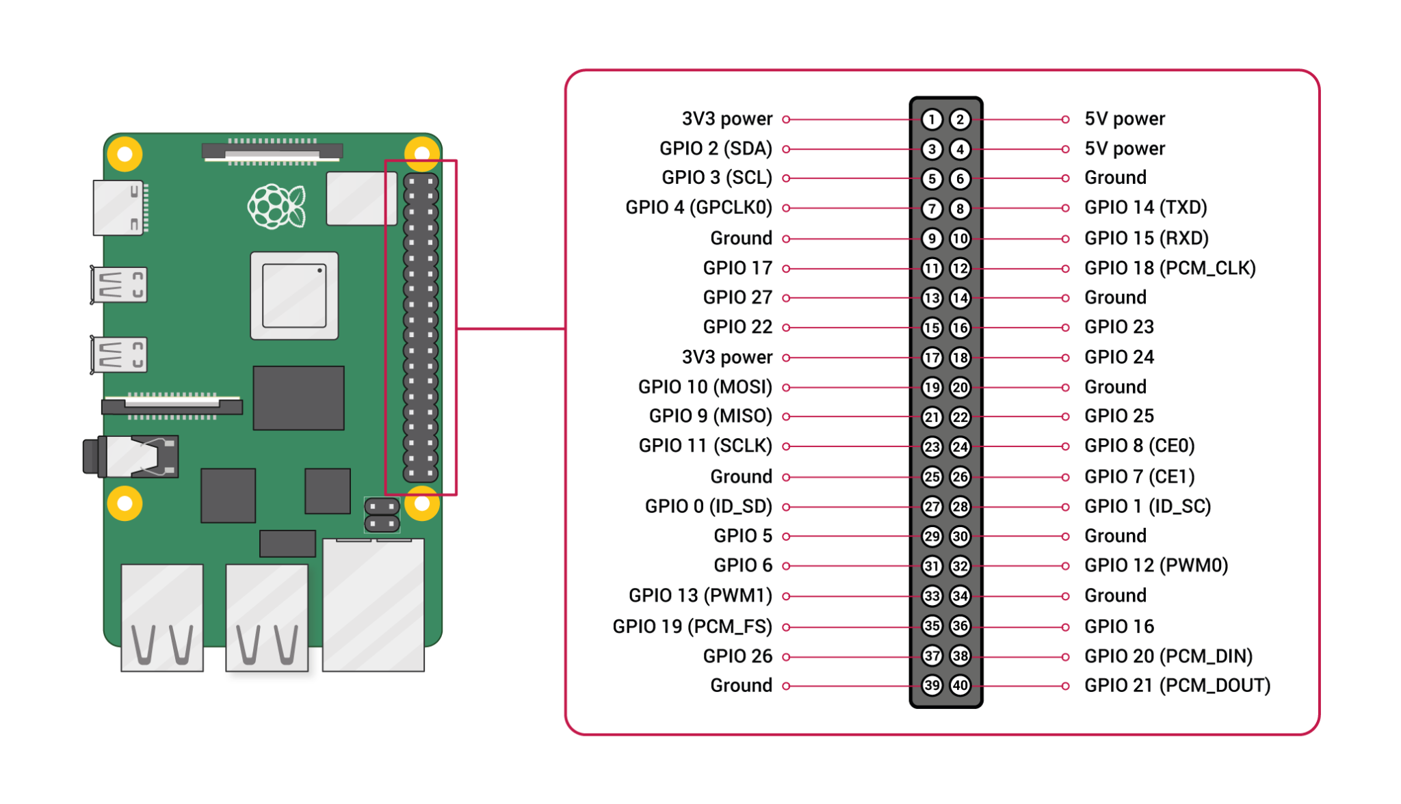
Data Measurement
Raspberry Pi Model B
I2C Sensor Protocol, read bus data with Python
Useful for real-time data processing
Small size- emulates field deployment
Drawbacks:
No built-in ADC
Limited linux & I2C experience
Raspberry Pi Model B
Raspberry Pi Pinouts
Notes:
Avery

Slide 30
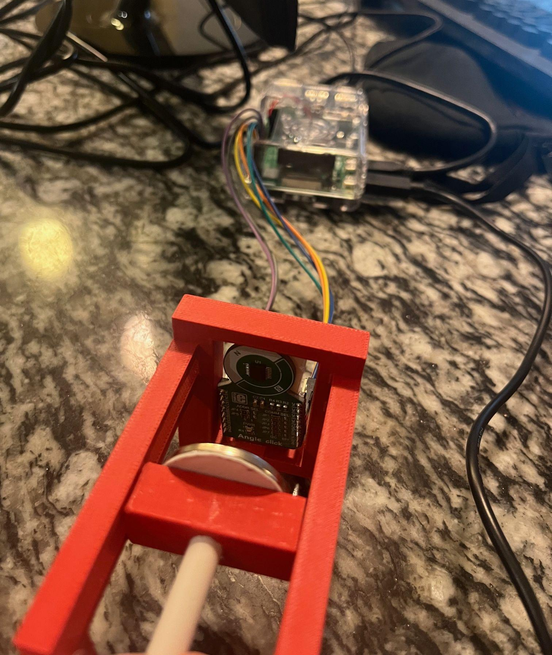
Hall Effect Installation
Hypothetical Installation Plan:
Use test rig to find maximum allowable gap between sensor & magnet.
Drill 0.5in hole into bottom of ball valve, install magnet into bored valve.
Install HE sensor inside hole & cover with external casing, making sure maximum magnet tolerance is met
Hall Effect Sensor with test apparatus
Notes:
Avery

Slide 31
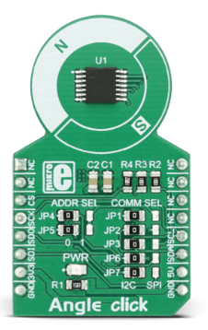
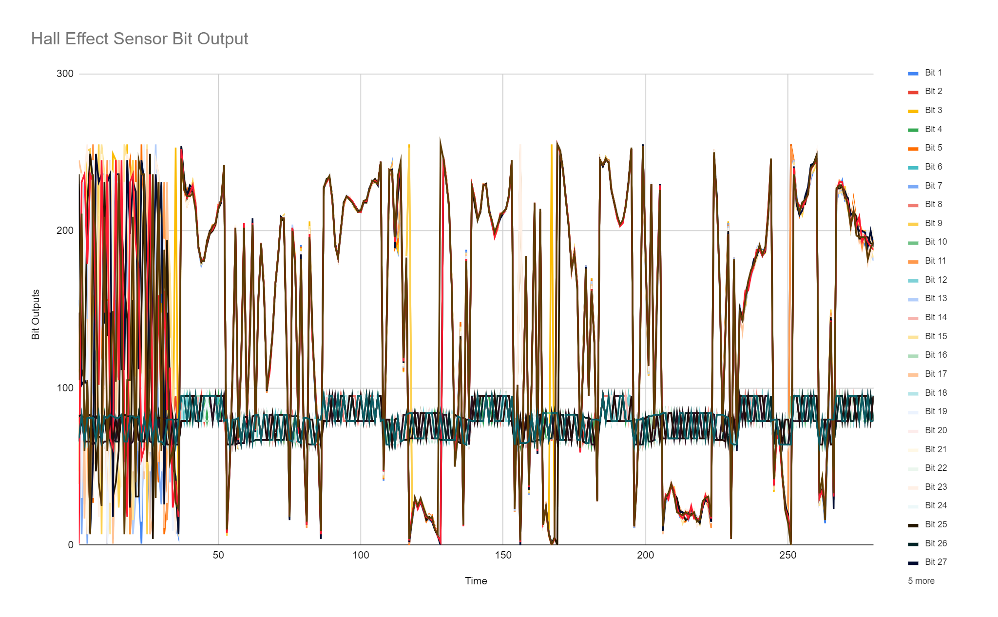
Hall Effect Learnings
MikroE Angle Click Sensor Board:
Used A1335 Hall Effect Sensor
Couldn’t access data with normal I2C protocol
Couldn’t find MSB/ LSB addresses, could only access all 32 registers
Tried to find correlation between registers & magnet rotation.
Only found correlation for magnetic field strength, max range of ≈ 3 in.
Angle Click Hall Effect Sensor
Sensor I2C bus read on all 32 registers
Notes:
Avery

Slide 32
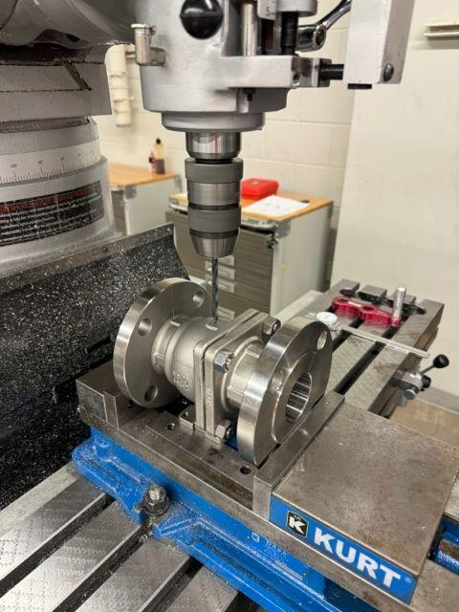
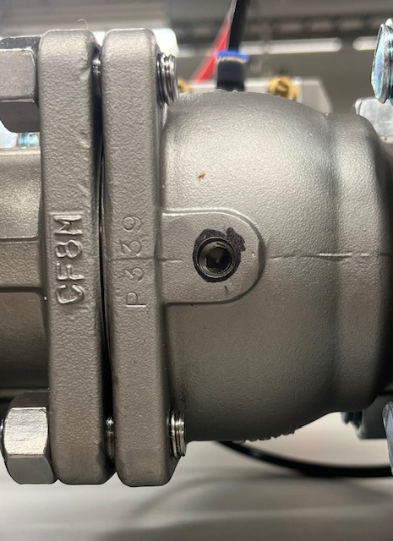
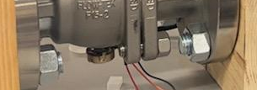
Potentiometer Installation
Drilled a 0.5in hole through the rotating axis of the valve.
Inserted the potentiometer shaft into the hole.
The potentiometer stem was epoxied to the floating ball and the potentiometer base was epoxied to the valve case.
Potentiometer wired to the PI for testing
Figure: Ball valve drilling.
Figure: Aligned base holes.
Figure: Wired potentiometer.
Notes:
Zack

Slide 33
Potentiometer Validation
Table: Potentiometer “Closed” Data Readings.
Toggled valve between 0 and 90 degrees
~0 degrees - open
~90 degrees - closed
Sampled n = 30 for each psi setting
Tested at 40, 50, 60, 70, and 80 psi
% error = 2*stdev/avg (should be 95% of data points within this bound)
PSI | 40 | 50 | 60 | 70 | 80
Average (Degrees) | 90.26 | 90.37 | 90.52 | 90.79 | 91.11
St.Dev. | 0.55 | 0.38 | 0.44 | 0.64 | 0.46
High | 90.74 | 90.89 | 91.02 | 91.41 | 92.31
Low | 85.14 | 85.18 | 85.85 | 85.06 | 85.26
% error | 1.23 | 0.83 | 0.97 | 1.39 | 1.011
Table: Potentiometer “Open” Data Readings.
PSI | 40 | 50 | 60 | 70 | 80
Average (Degrees) | 0.036 | 0.036 | 0.035 | 0.034 | 0.034
St.Dev. | 0.0053 | 0.0052 | 0.0053 | 0.0051 | 0.0051
High | 0.05 | 0.05 | 0.05 | 0.05 | 0.05
Low | 0.025 | 0.0.025 | 0.025 | 0.025 | 0.016
% error | 30 | 29 | 30 | 30 | 30
Notes:
Zack

Slide 34
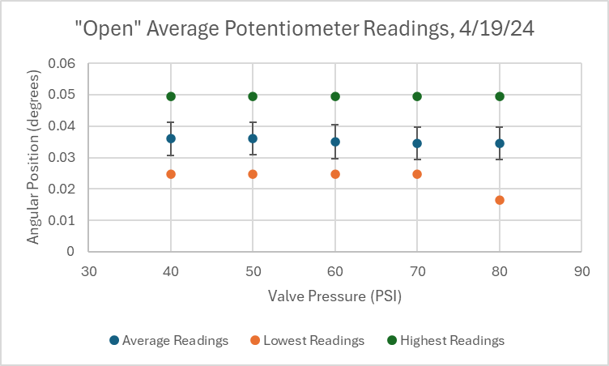
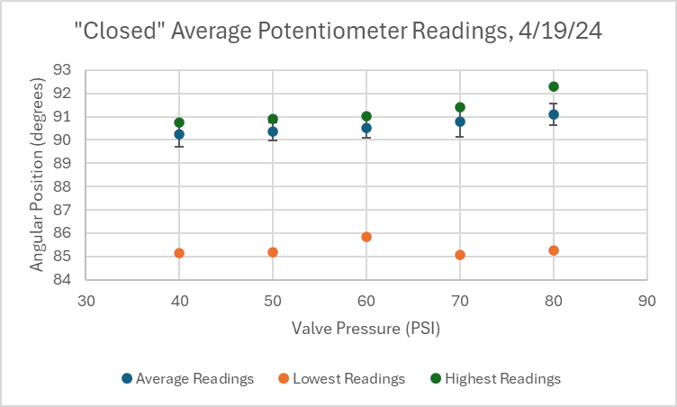
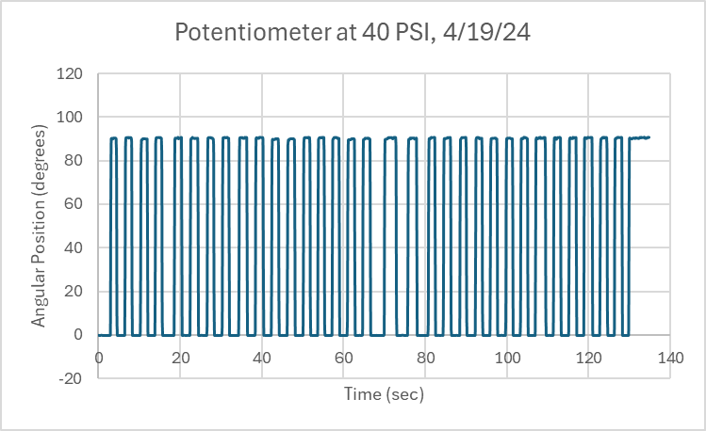
Potentiometer Validation Plots
Error bars are standard deviation
“Low” readings are reflective of conservative classification for closed, and vice versa
Notes:
Zack

Slide 35
Positioner and the Potentiometer
Real 0 position on potentiometer
Potentiometer had a dead zone from about 0 to 20 degrees.
After this dead zone the potentiometer works as expected.
Solution: offset initial installation so that measured “0” is at about 40 degrees.
Dead zone
20°
Dead zone
Optimal Potentiometer range
Figure: Potentiometer reading chart.
Notes:
Zack

Slide 36
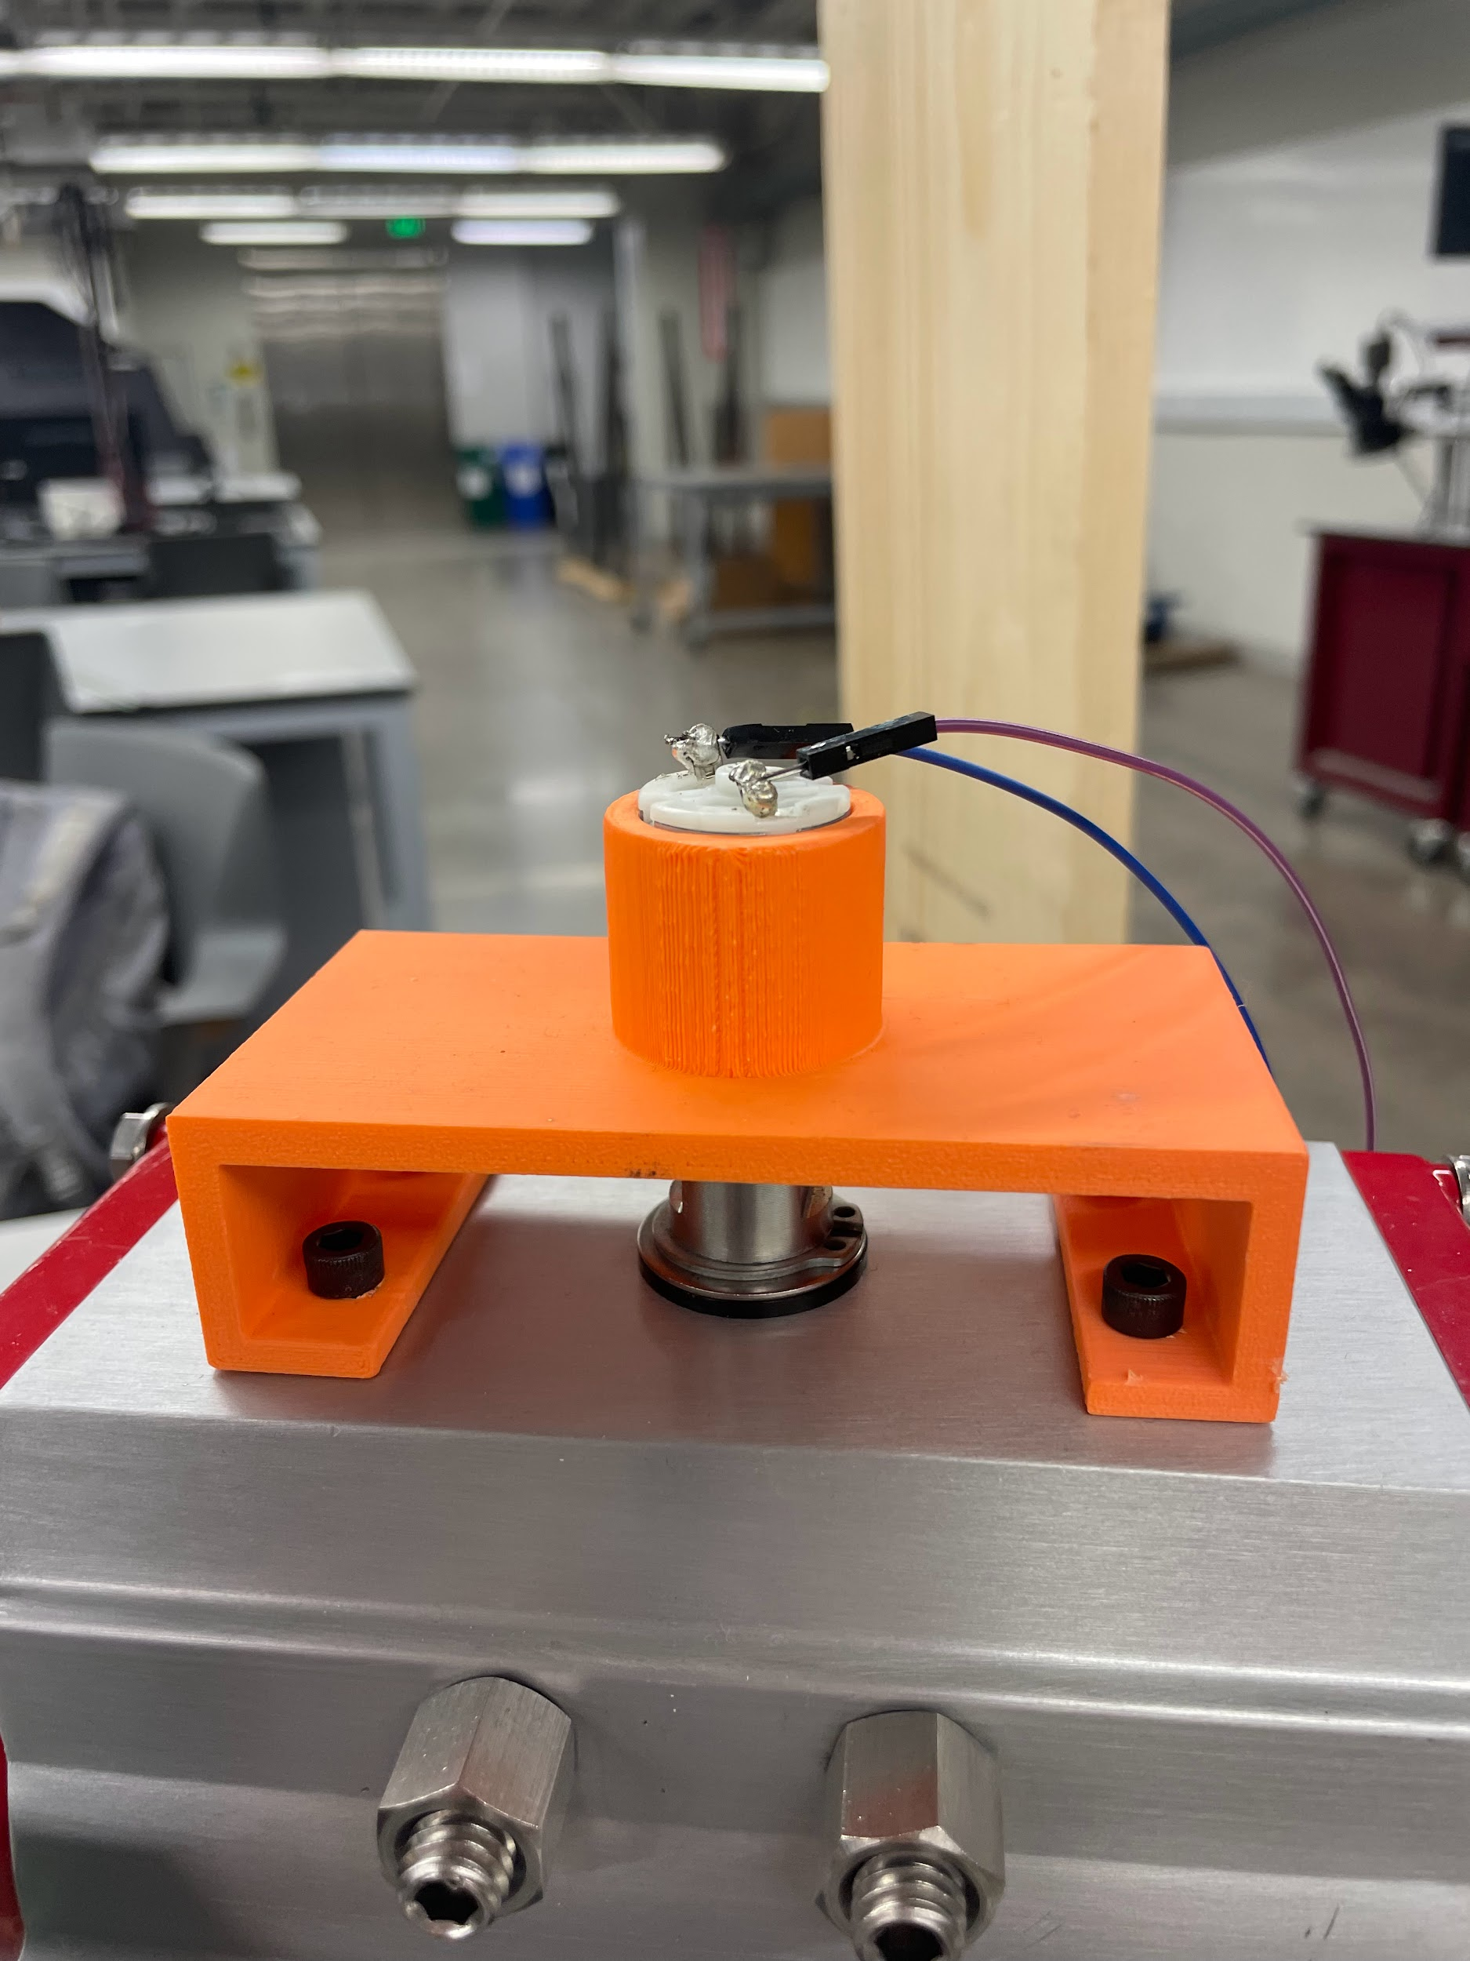
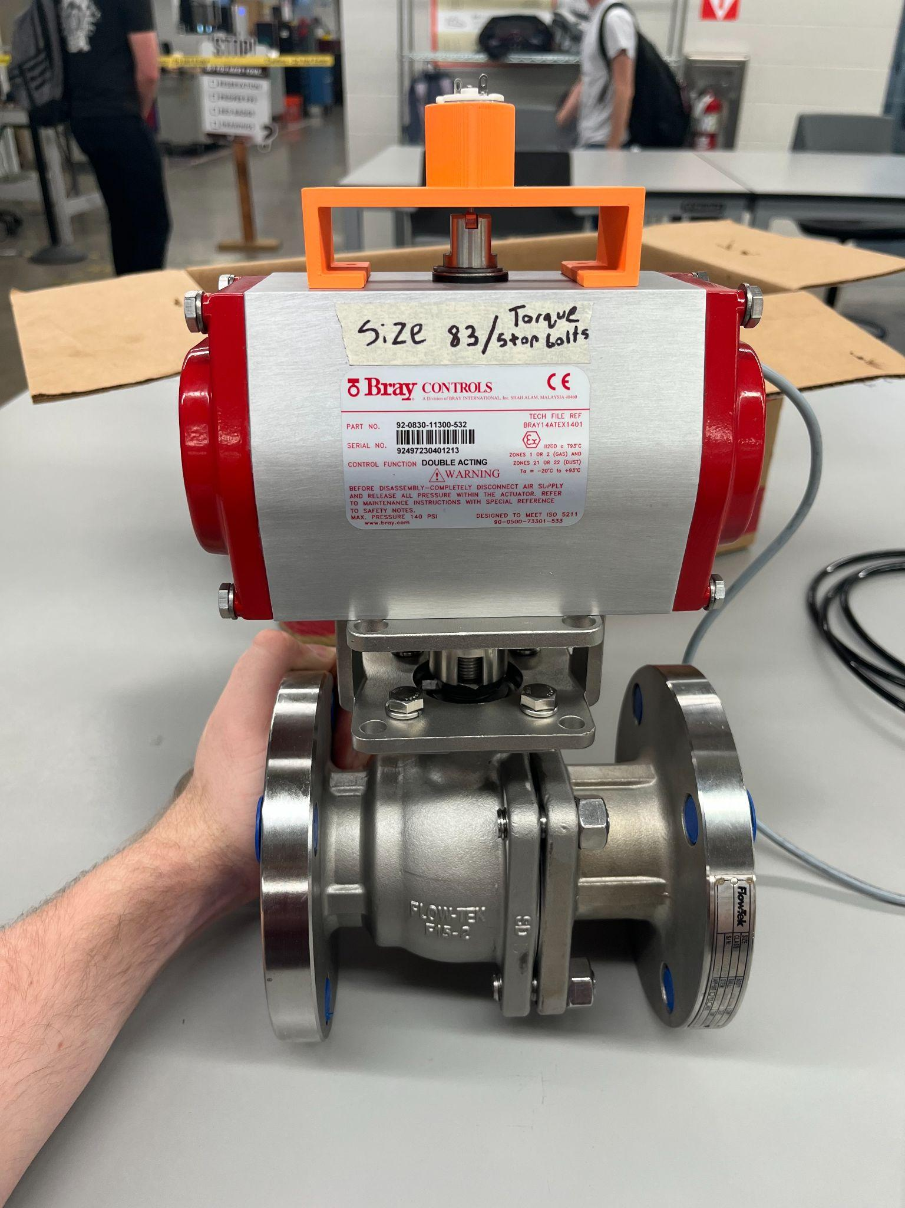
DC Motor Installation
3D printed motor brace and attached it to the roof of the actuator
Pressure fit the motor into the slot
3D printed the plastic slot attachment to connect the motor shaft and actuator stem.
Wired the motor outputs to the Pi
Figure: Motor bracket and wired connections.
Figure: Size 83 actuator with bracket.
Notes:
Zack

Slide 37
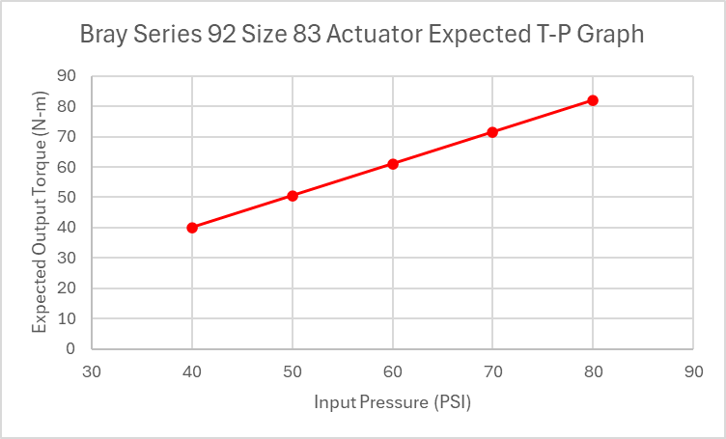
DC Motor Validation
Rotated valve between 0 to 90 degrees
Sampled n = 30 for each psi
Table: DC motor voltage readings vs expected torque
Pressure (PSI) | Avg. Max V | Avg. Min V | % error (max) | % error (min) | Expected Torque (N-m)
40 | 0.0112 | -0.0108 | 9.661 | 3.992 | 40
50 | 0.0115 | -0.0119 | 4.567 | 2.371 | 50.5
60 | 0.0123 | -0.0126 | 5.189 | 11.78 | 61
70 | 0.0126 | -0.0130 | 6.305 | 2.266 | 71.5
80 | 0.0121 | -0.0131 | 5.969 | 2.934 | 82
Notes:
Zack

Slide 38
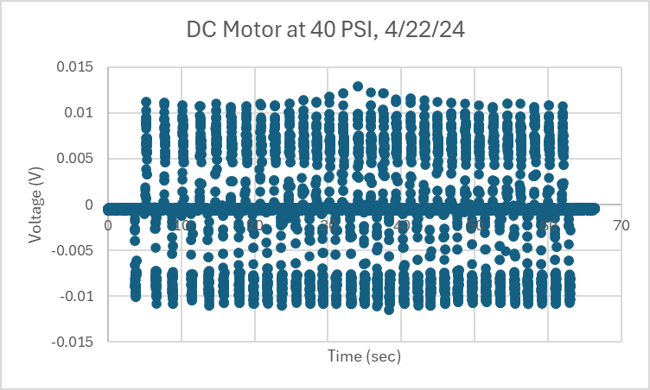
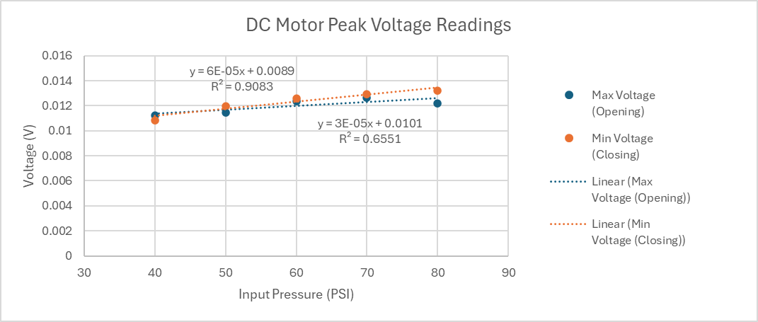
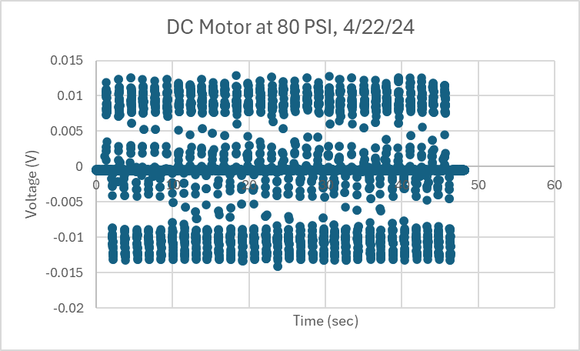
DC Motor Validation Plots
Notes:
Zack

Slide 39
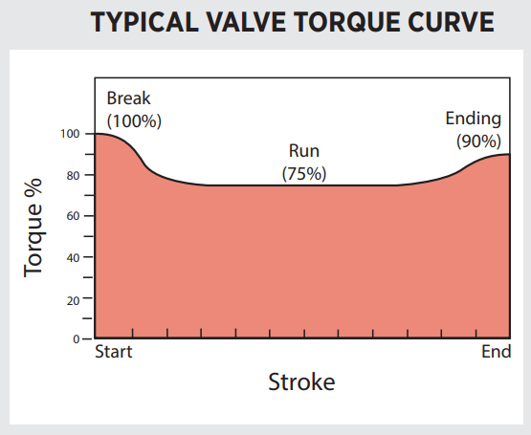
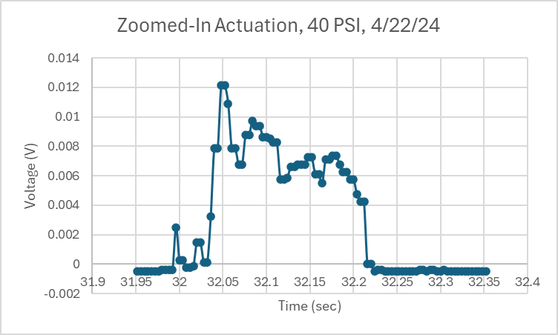
DC Motor Validation Plots
Notes:
Zack

Slide 40
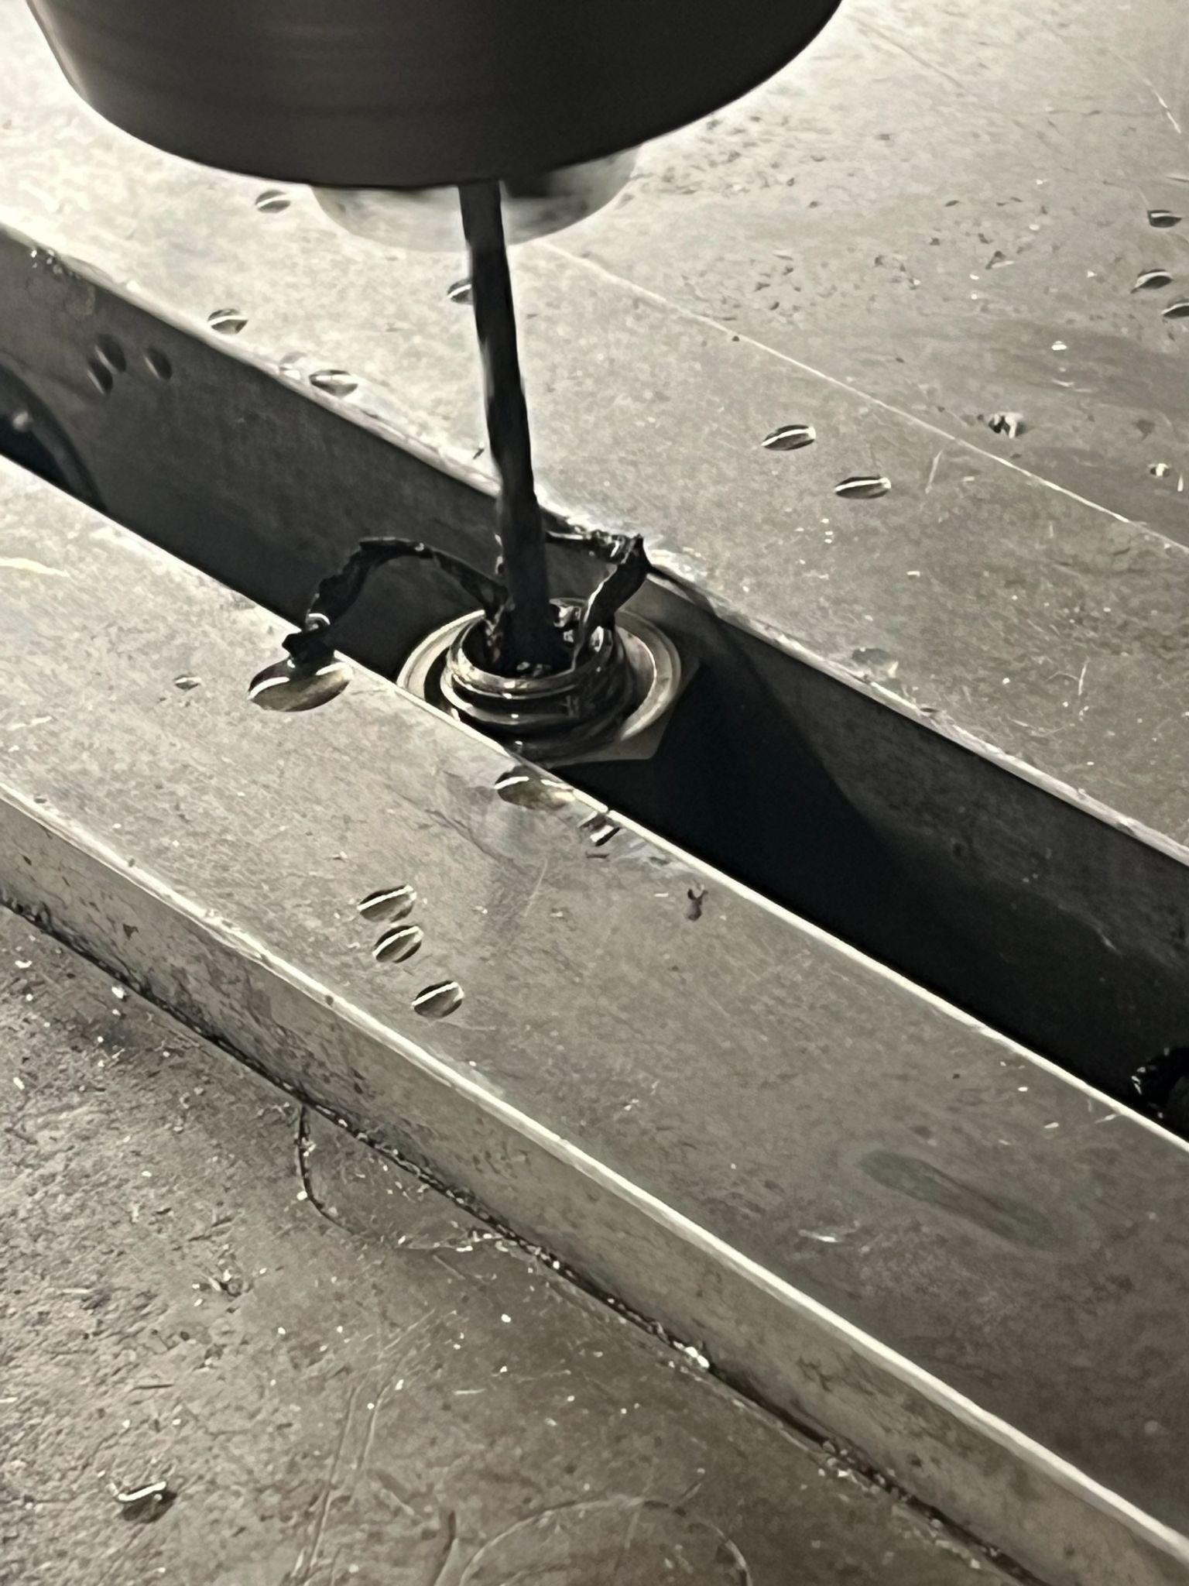
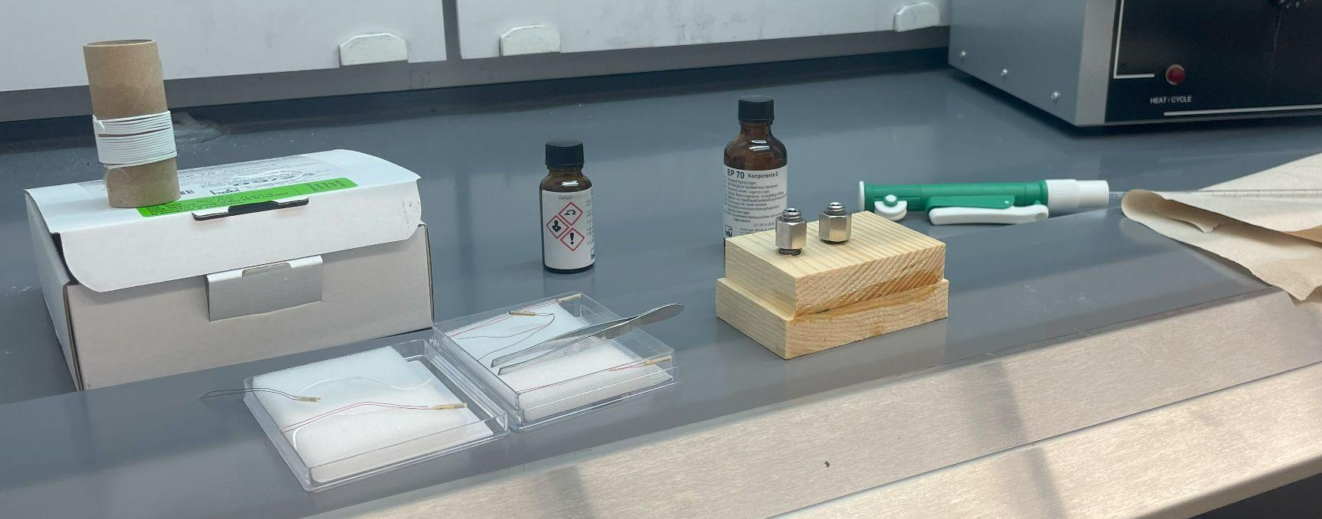
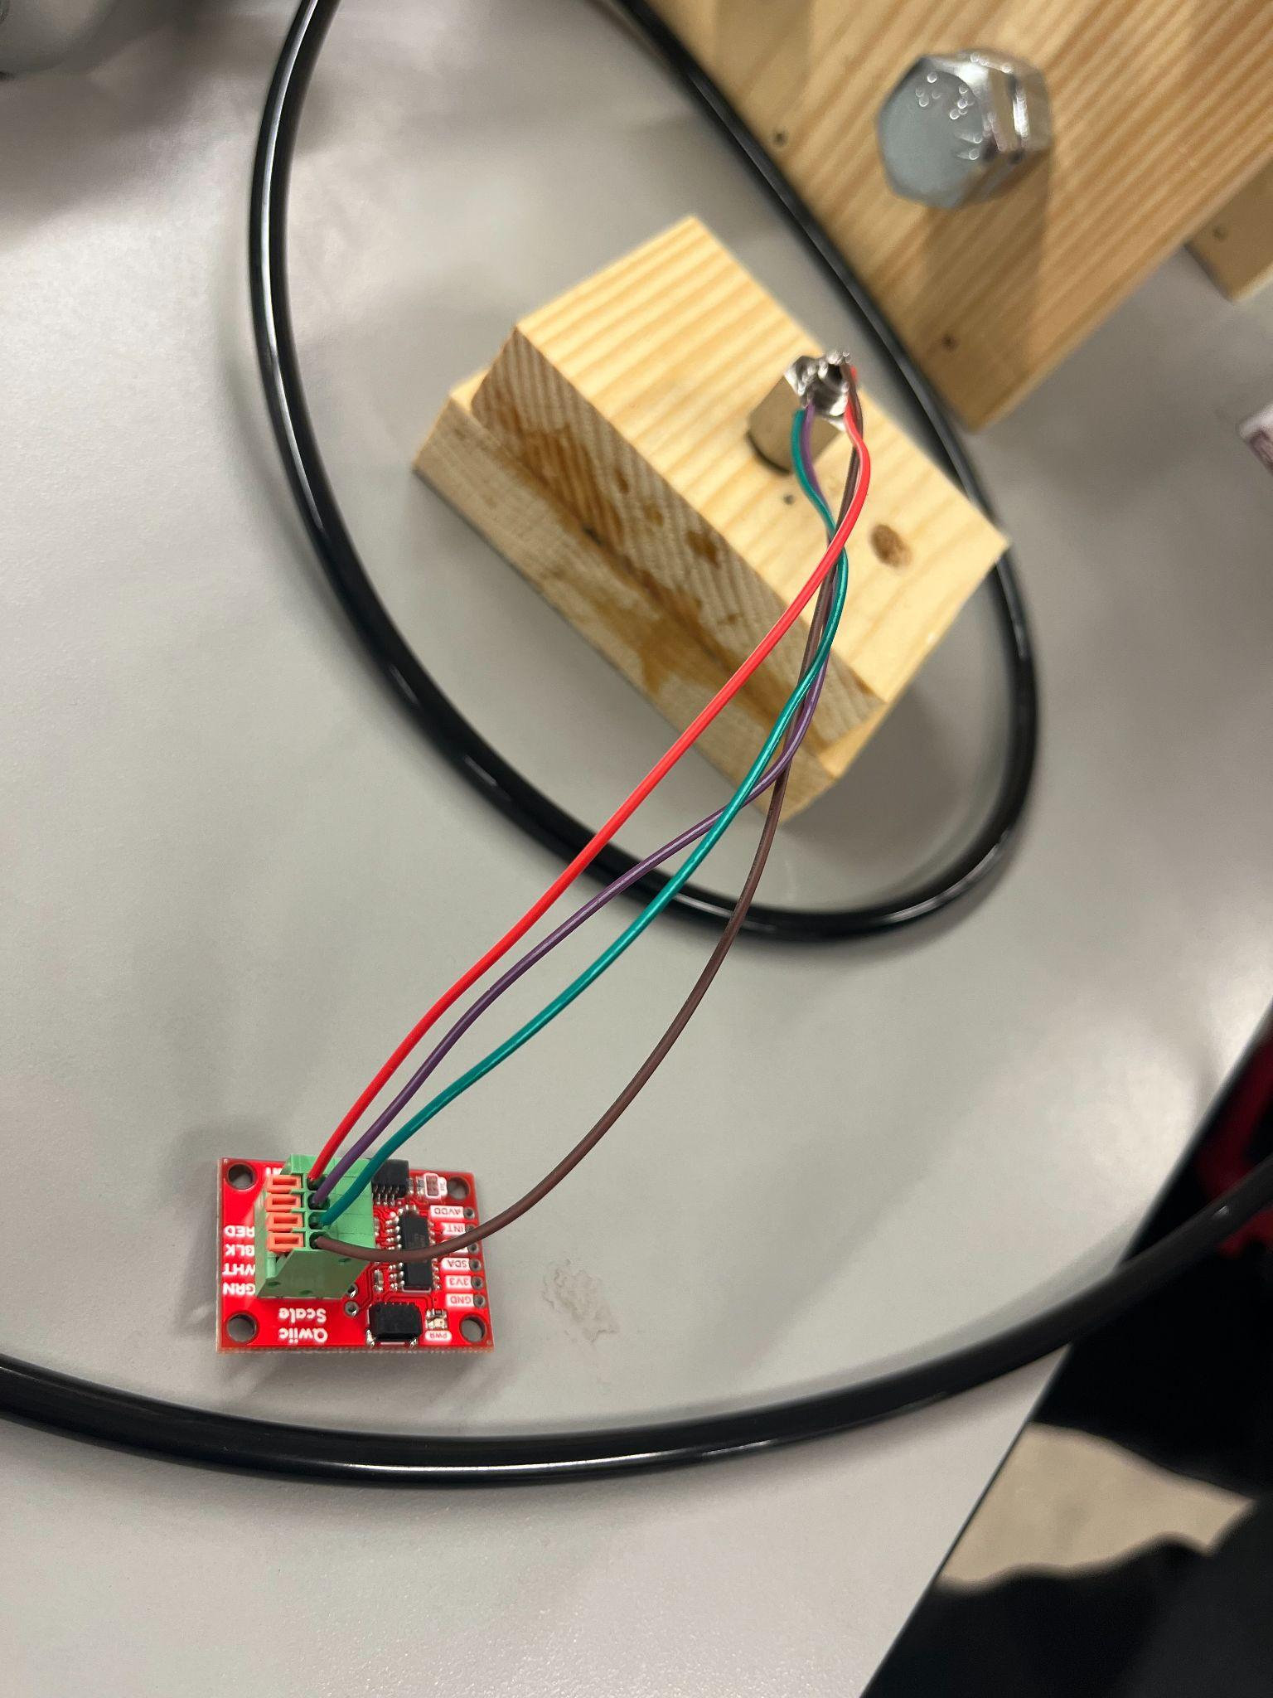
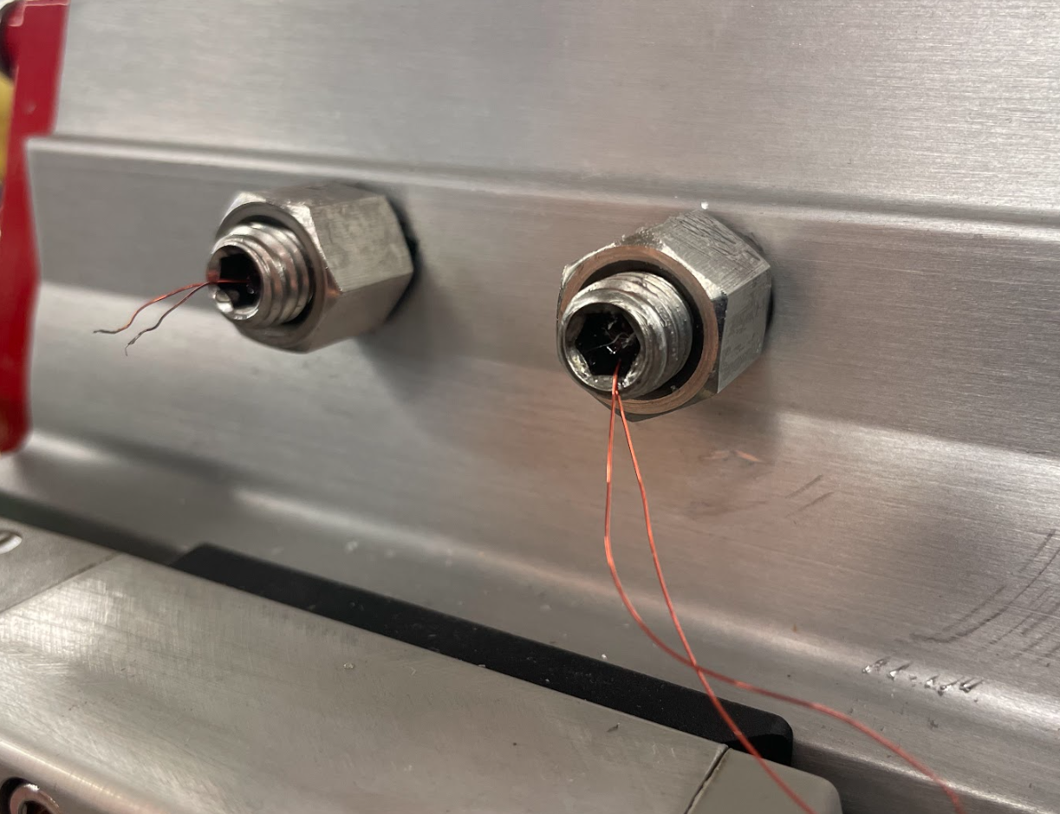
Strain Gauge Installation
Drilled 2mm holes in center of stop bolts
Epoxied nuts onto the stop bolts
Used the chemical hoods and HBK’s epoxy to insert them into the drilled holes
Cured in an oven at 140℉ for 3 hours
Using the nuts screwed the strain gauges into the actuator
Wired to a load cell amplifier and the Pi board
Epoxying the Strain gauges into the bolts use proper PPE and Curing
Drilling into the stop bolts
Soldering the strain gauges to the load cell amplifier
Inserting the finished strain gauge bolts into the actuator
Notes:
Locke

Slide 41
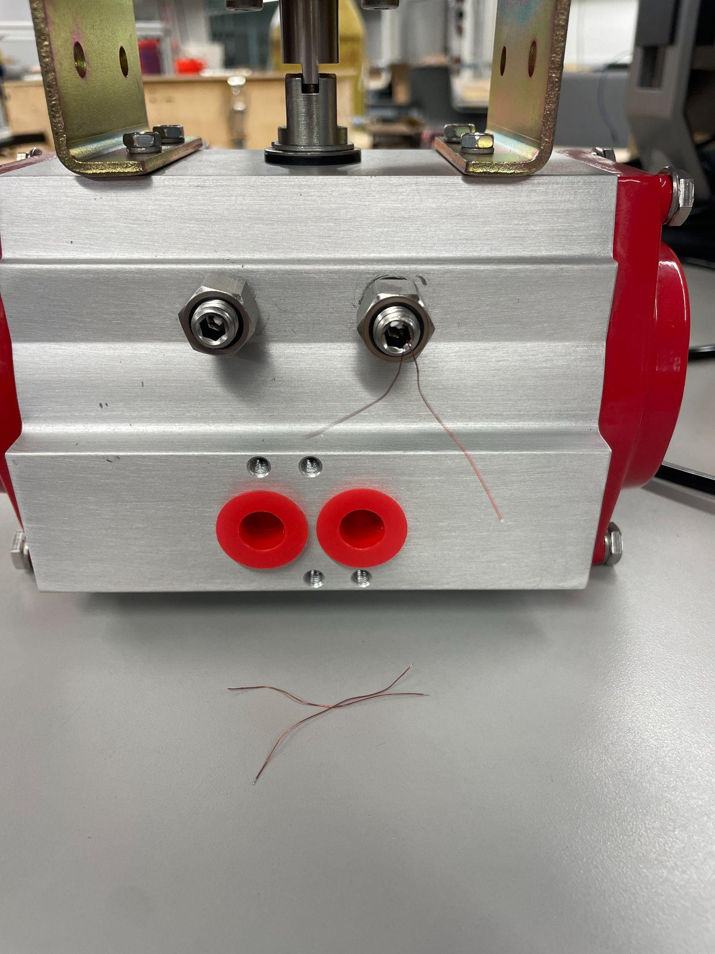
Strain Gauge Validation
Strain Gauges did not change readings staying at a constant 120 ohms.
Potential Failures
Load cell board does not supply necessary amplification
Multiple drillings and installments made a weak connection between bolt and strain gauge
Strain gauges deemed too weak physically to be a viable option in industrial use.
Strain Gauges that broke during initial installation
Notes:
Locke

Slide 42
Validation Discussion

Slide 43
Requirements Validation - Position
Table: Validation requirements set for the position deliverable
Functional Requirement | Quantitative Requirement | Design feature | Validation Test | Actual Value | Satisfied
Measurement Accuracy Position | < 2% | Potentiometer | Measure the reading of the potentiometer to the known degrees of rotation | +/- 1.4% | Y
Surrounding metals do not interfere with accuracy | <2 % | Hall effect sensor and magnet | Attach a magnetic point to the edge of the butterfly disc and measure change in magnetic field due to rotation | ? | Could not read exact field data with sensor
Ease of implementation potentiometer | < 2 hr | Prototype Apparatus | Time how long it takes to set up the sensors on the prototype valve system | 3hr-5hr | N
Calibration Time potentiometer | < 1 hr | Sensor | Time how long it takes the team to start getting accurate readings from the sensor system from start to finish | 1hr | Y
Measurement accuracy with extended use (position) | < 2% | Potentiometer and Hall Effect Sensor | Measure the decay of accuracy as the potentiometer cycles till failure | 1000 cycles | No noticeable drop off
Notes:
Locke

Slide 44
Requirements Validation - Torque
Table: Validation requirements set for the torque deliverable
Functional Requirement | Quantitative Requirement | Design feature | Validation Test | Actual Value | Satisfied
Measurement Accuracy Torque | < 5% | Cylindrical Strain Gauge or Motor | Measure and compare the reading of the torque reading to the actual set value | 10% | N
Ease of implementation motor | <2 hr | Prototype Apparatus | Time how long it takes to set up the sensors on the prototype valve system | 30 min | Y
Calibration Time | < 1 hr | Sensor | Time how long it takes the team to start getting accurate readings from the sensor system from start to finish | 10 min | Y
Measurement accuracy with extended use (torque) | < 5% | Cylindrical Strain Gauge or Motor | Measure the decay of accuracy as the rotational torque bracket or potentiometer cycles till failure | 1000 cycles | No drop off
Notes:
Locke

Slide 45
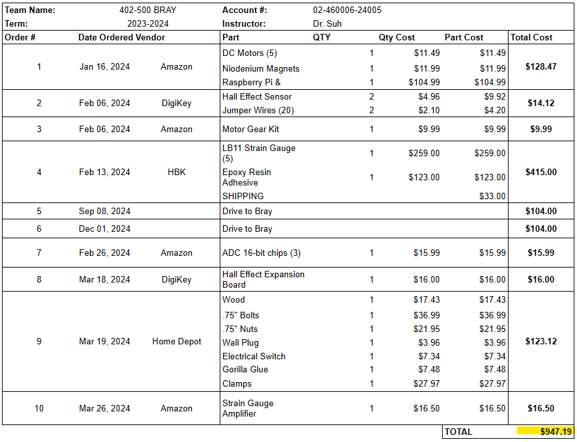

Expenditures
Original approved budget:
$3,000
Notes:
Avery

Slide 46

Gantt Chart
Notes:
Michael

Slide 47
Lessons Learned Potentiometer
Position Potentiometer about 40 degrees off its 0 degrees to avoid the dead zone.
Ensure that output prongs do not contact metal valve casing.
Potentiometer has some movement range with the floating ball valve. But could be more precise on the butterfly valve due to lack of translational movement.
Notes:
Michael

Slide 48
Lessons Learned DC Motor
The voltage does increase with the faster actuations from higher pressure and generally follows the torque curve.
A better motor that provides extensive documentation over the impedance will give more insight into the back emf readings and Torque calculations.
Notes:
Michael

Slide 49


Lessons Learned Strain Gauges
Be very, very careful with the strain gauge wires - no attachments until they are in the actuator
Concept works, physical implementation is difficult - got initial readings but then breakage
Notes:
Michael

Slide 50
Lessons Learned Hall Effect
Concept still shows promise in terms of manufacturing
Installation in ball valve allows ‘float’ on bottom end
Impact of use with ferrous material valves needs studied
Objective not reached due to time constraints
Sensor Selection: Adopt a development board ecosystem for testing, or research breakout boards agnostic to OS.
Notes:
Michael

Slide 51
Future Work & Recommendations
Rotary potentiometer works, but takes away from the “floating” ball valve
DC motor with datasheet and better quality would be a valid non-invasive solution for actuator torque
Hall effect sensor is promising and merits further research and testing
Strain gauges are very sensitive so may not be ideal unless careful manufacturing practices are maintained
Notes:
Michael

Slide 52
THANK YOU!
Dr. Wei Chen
Dr. Steve Suh
Fischer EDC
Dr. Joanna Tsenn
Dr. Jonathan Weaver-Rosen
Oscar Jimenez
Annie Tran
Mechanical Engineering Dept.
Bray Engineering Team
Vendors
Notes:
Michael

Slide 53
References
[1]“Piping Codes and Valve Standards”. Valve Magazine, September 29, 2015,
https://www.valvemagazine.com/articles/piping-codes-and-valve-standards. Accessed 25 October 2023.
[2]“Fluid Power Actuators Explained”. Rotork Fluid Systems, May 2016, https://www.rotork.com/uploads/documents-versions/24733/1/pub010-024-00_0516.pdf. Accessed 11 September 2023.
[3]“Pneumatic Actuator: Series 92/93 Rack & Pinion Pneumatic”. Bray International, Inc, n.d., https://www.bray.com/valves-actuators-controls/actuators/pneumatic-actuator/series-92-93-pneumatic-actuator. Accessed 11 September 2023.
[4]“Scotch Yoke Pneumatic Actuator: Series 98”. Bray International, Inc, n.d., https://www.bray.com/valves-actuators-controls/actuators/pneumatic-actuator/series-98-scotch-yoke-pneumatic-actuator. Accessed 11 September 2023.
[5]“Mark-10 MTT03C-100 Hand-held Cap Torque Meter CAP-TT03-100”. ABQ Industrial, n.d., https://www.abqindustrial.net/store/mark-10-mtt03c-100-hand-held-cap-torque-meter-cap-tt03-100-100-lbf-in-capacity-p-807-op-1306_4671.html. Accessed 25 October 2023.
[6]“Torque Sensor - Valve Torque Testing”. Futek Advanced Sensor Technology, n.d., https://www.futek.com/applications/Valve-Torque-Testing. Accessed 23 October 2023.
[7]“A Comprehensive Guide on Butterfly Valve Vs Ball Valve”. Dombor Valve, 2021, https://www.dombor.com/ball-valve-vs-butterfly-valve/. Accessed 11 September 2023.
[8]“Rotary Potentiometer - 10k Ohm, Linear”. Osoyoo, May 7, 2015, https://osoyoo.com/2017/05/07/rotary-potentiometer-10k-ohm-linear/. Accessed 29 October 2023.
[9]”Cylindrical Strain Gauges” , HBK, https://urldefense.com/v3/__https://www.hbm.com/en/7452/cylindric-strain-gauges-for-measurements-in-bolts/?product_type_no=LB11*TB21*20Strain*20Gauges*20for*20Measuring*20in*20Screws*20&*20Bolts__;LyUlJSUlJSUl!!KwNVnqRv!D9Ef3vPu0aZQhc7RLKtv_F_0ptA4-baKgBz2qm5KfQ57GkAa8nQAN9R7XYwxzJueRnq8yxMvErTp04wVIMVGhQr57Ok-EDJCuA$
Notes:
Michael

Slide 54
References
[10] Understanding D.C. Motor characteristics. D.C. Motor Torque/Speed Curve Tutorial:::Understanding Motor Characteristics. (n.d.). http://lancet.mit.edu/motors/motors3.html
Notes:
Michael

